Slide 1






HOSPITAL Management SYSTEM
Structural Design with Composite Pattern
Khalil Al-Masri
Qasim Al-Humaidi
Mohammed Al-Homsi
Mahmoud Nemer
PATTERN PROGRAMMING PROJECT • MAY 2026

Slide 2





Project Scope
GENERAL OBJECTIVES
PRIMARY PATTERN FOCUS
Design a scalable organizational structure for a modern hospital environment.
Implementation of the Composite Pattern as the core structural foundation.
Apply software engineering principles to manage complex multi-level entities.
Ensuring uniform treatment of individual staff and entire departments.

Slide 3



The Structural Problem
Hierarchical Depth
Hospitals contain many levels (Main Admin → Depts → Units → Staff). Managing this multi-level tree manually leads to fragmented and complex code.
Type Inconsistency
Treating a "Department" differently from an "Employee" requires complex if-else logic and duplicate code for similar operations.
Manual Aggregation
Calculating total payroll or headcounts across branches requires repetitive, error-prone manual loops that are difficult to scale.

Slide 4



Solution: The Composite Pattern
"Compose objects into tree structures to represent part-whole hierarchies. Composite lets clients treat individual objects and compositions of objects uniformly."
Tree Structure
Uniformity
Part-Whole
Organizes entities into a recursive hierarchy of parents and children.
The client interacts with a single interface for both leaves and composites.
Perfectly models the relationship between staff and departments.

Slide 5



Composite Core Elements
Component
Leaf
Composite
The base interface that defines common operations for all objects in the hospital hierarchy.
Represents individual staff members. These are end-nodes that do not contain other components.
Represents departments or units. They store child components and implement recursive logic.
HospitalComponent
EmployeeLeaf
Department

Slide 6




Implementation Hierarchy
Top Level: Hospital Administration
Middle Level: Clinical Departments
The Root Composite node that manages the entire organizational tree.
Sub-Composite nodes (e.g., Cardiology, ER) containing further
units or staff.
Bottom Level: Medical Staff
The Leaf nodes (Doctors, Nurses) representing individual entities with no children.
Uniform Operation: Every level responds to the same interface methods.

Slide 7
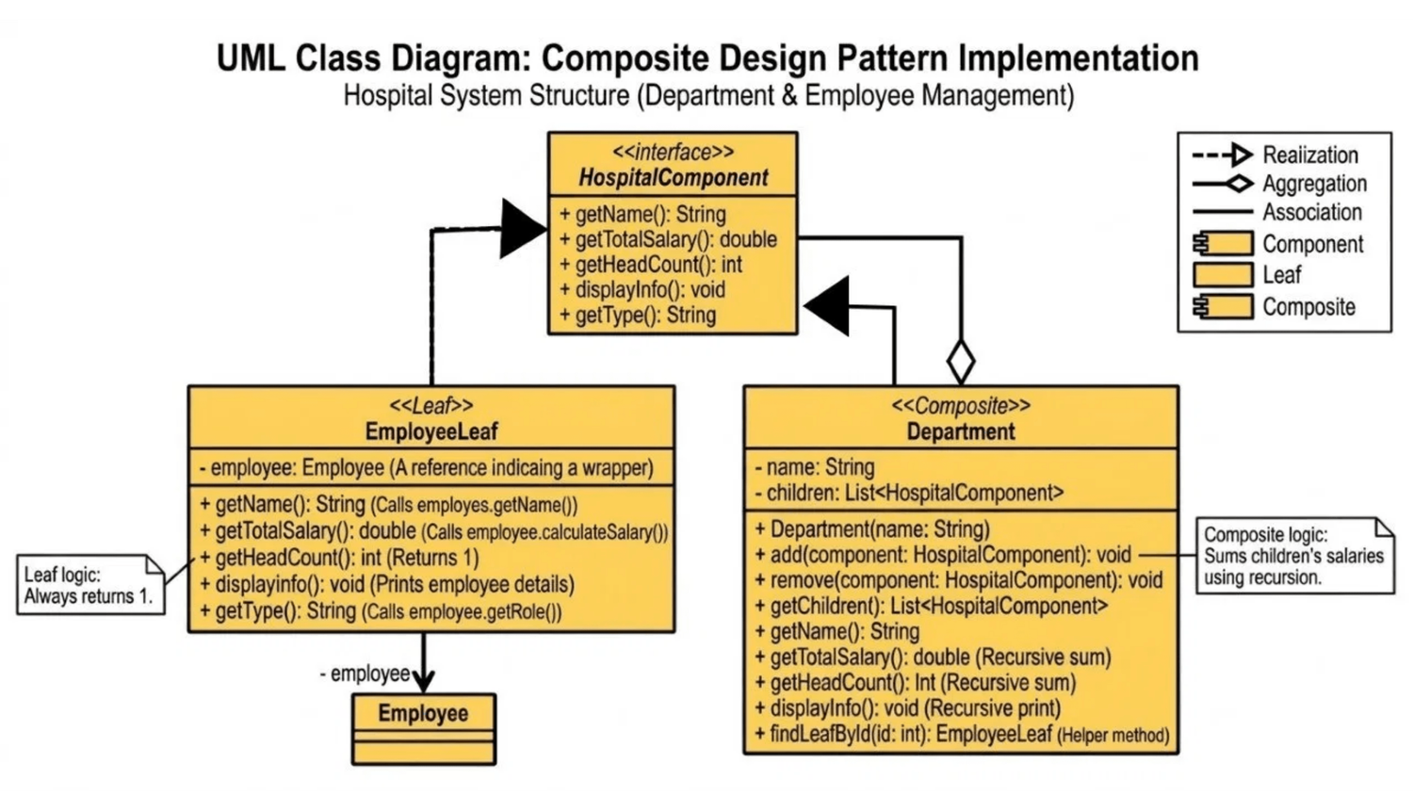



UML Architecture
Structure
Visual representation of the Composite Pattern implementation in the Hospital System.
Relationships
Clear mapping of Realization and Aggregation between components.
Nodes
Defines the roles of EmployeeLeaf and Department composites.

Slide 8
Recursive Logic in Action
// Implementation in Department.java
@Override
How it Works
public double
getTotalSalary
() {
double
total = 0;
The Department class iterates through its collection of children without knowing their specific type.
for
(HospitalComponent child : children) {
// Recursive delegation
total += child.
getTotalSalary
();
}
By delegating the call to getTotalSalary(), the system automatically traverses down the tree.
return
total;
}
This recursive traversal ensures that a single call at the root level aggregates data from all branches and leaves.

Slide 9



Key Benefits of Composite
Simplified Client Code
Ease of Extension
Automated Traversal
The UI doesn't need to check if it's dealing with a leaf or a composite. It interacts with the HospitalComponent interface uniformly.
New department types or specialized staff roles can be added without changing the existing base logic or client code.
Built-in support for recursive operations across the entire tree, such as calculating total payroll or staff counts.

Slide 10




Design Trade-offs
Advantages
Challenges
Clean Architecture: Decouples client code from the concrete classes of the hierarchy.
Over-Generalization: Leaf nodes might inherit methods that are only relevant to composites.
High Maintainability: Structural changes are localized within the Composite nodes.
Performance: Deep recursive traversals may require optimization for large datasets.
Structural Clarity: Explicitly models the part-whole relationship of the hospital.
Complexity: The abstraction layer can make the system harder to debug for new developers.

Slide 11




System Demonstration
Dynamic Tree View
Uniform Operations
The GUI uses a JTree component to visually represent the hospital's hierarchical structure, directly mapping to the Composite pattern.
Adding, searching, or modifying an employee or a department uses the same underlying logic, simplifying the management module.
Live Aggregation
Structural Integrity
Real-time updates of salary totals and staff counts as the hierarchy changes, powered by recursive tree traversal.
Ensures that departments can contain other departments or staff, while staff members remain as leaf nodes with no children.

Slide 12





Conclusion
Project Success
Pattern Impact
The Composite pattern successfully resolved the hierarchical complexity of the hospital system.
Created a scalable foundation for future organizational expansions.
Established a maintainable architecture that reduces long-term technical debt.
The implementation meets 100% of the structural requirements for the Pattern Programming course.

Slide 13

QUESTIONS?
Thank You for Your Attention!
Link of Project
PRESENTED BY
Khalil Al-Masri
Qasim Al-Humaidi
Mohammed Al-Homsi
Mahmoud Nemer

